Slide 1
Lecture 20: Timing Analysis – II
Tsung-Wei (TW) Huang
Department of Electrical and Computer Engineering
University of Utah, Salt Lake City, UT

Slide 2
In-class Presentation: 12/5
Routing research presentation on 12/5 (in class)
Siting Liu, Yuan Pu, Peiyu Liao, Hongzhong Wu, Rui Zhang, Zhitang Chen, Wenlong Lv, Yibo Lin, Bei Yu, "FastGR : Global Routing on CPU-GPU with Heterogeneous Task Graph Scheduler," IEEE Transactions on Computer-Aided Design of Integrated Circuits and Systems (TCAD), 2022
Chris Chu and Yiu-Chung Wong. FLUTE: Fast Lookup Table Based Rectilinear Steiner Minimal Tree Algorithm for VLSI Design. In IEEE Transactions on Computer-Aided Design, vol. 27, no. 1, pages 70-83, January 2008.
Upload your pptx to https://github.com/tsung-wei-huang/ece5960-physical-design/issues/14 before presentation

Slide 3
In-class Presentation: 12/7
Routing research presentation on 12/7 (in class)
Shiju Lin, Jinwei Liu, and Martin D F Wong, "GAMER: GPU-accelerated Maze Routing", IEEE/ACM International Conference On Computer Aided Design (ICCAD), 2021
Zizheng Guo, Feng Gu, and Yibo Lin, "GPU-Accelerated Rectilinear Steiner Tree Generation," IEEE/ACM International Conference On Computer Aided Design (ICCAD), 2022
Upload your pptx to https://github.com/tsung-wei-huang/ece5960-physical-design/issues/15 before presentation

Slide 4
Programming Assignment #3: Routing
Goal: Implement a Steiner Tree Construction Algorithm
Pins to connect
Route it so we guarantee each 2-point path
is shortest;
Redraw it--different
orientations
of 2-point paths
Now we can see the
better (shorter)
Steiner tree
Due 12/16: https://github.com/tsung-wei-huang/ece5960-physical-design/tree/main/PA3

Slide 5
Recap: Timing Analysis Model
Assume we know clock cycle: e.g., 1GHz clock, cycle = 1ns
For this logic to work successfully, longest delay through network must be shorter than 1ns
Logic
Longest delay <1ns
Flip Flops
Flip Flops
•
•
•
•
•
•
1 ns
CLOCK
(For simplicity, ignore some flip flop timing issues)

Slide 6
Static Timing Analysis (STA)
When we ignore logic, this is called Topological Analysis
We only work with the graph and the delays – don’t consider the logic
We can get wrong answers: what we found was called a False Path
Going forward: we ignore the logic
Assume that all paths are statically sensitizable
Means: Can find a constant pattern of inputs to other PIs that makes some output sensitive to some input
This timing analysis is called Static Timing Analysis (STA)
Consider only the best- and worst-case timing results
Consider no logic (otherwise called dynamic timing analysis)
Notes:
Now, you probably can see, in this type of analysis, we only consider gate delay and do not consider the functionality of the circuit or the logic of the circuit. Evenything is done in an abstract graph model. When we ignore logic … (explain…)

Slide 7
Recap: STA Example
Consider only worst-/base-case delays
∆ = Gate delay
PI
∆=8
∆=8
∆=2
PO
∆=2
PI
∆=1
∆=1
PI
∆=1
Notes:
Let’s take a look at an example. Here, I have a simple graph model of three inputs, PI, and one output, PO, and seven gates. Each of the 7 gates has a delay value denoted by the delta. (explain …)
Now, based on this graph model. The job of timing analysis is to answer the questions “what is the longest path that gives the most delay?”

Slide 8
Recap: STA = Shortest Path Finding
PI = Primary Input, PO = Primary Output
Longest delay is 8+2+8+2=20
PI
∆=8
∆=8
∆=2
PO
∆=2
PI
∆=1
∆=1
PI
∆=1

Slide 9
Recap: STA Terminology
Delays are on edges; let clock cycle be 12
Compute the min/max delays “by eye” for now
AT=longest path from SRC TO node;
RAT=(cycle time 12) – (longest path FROM node to SNK)
Slack = RAT - AT
Cycle=12
1
3
2
0
5
1
0
SRC
0
4
3
0
SNK
0
1
4
2
0
2
3
5
PIs
POs

Slide 10
Recap: Compute ATs …
→ AT RAT slack_{L} = (RAT_{L} – AT_{L})
Compute ATs from SRC to SNK
Cycle=12
0
1
4
7
1
3
2
0
0
5
0
15
0
1
12
SRC
0
4
3
0
SNK
0
1
6
4
2
0
0
2
2
3
10
5
15
PIs
POs

Slide 11
Recap: Compute RATs …
→ AT RAT slack_{L} = (RAT_{L} – AT_{L})
Compute RATs from SNK to SRC
Cycle=12
0
-3
1
-2
4
10
7
12
1
3
2
0
-3
0
5
0
15
12
0
-1
1
12
12
SRC
0
4
3
0
SNK
0
1
6
3
4
2
0
2
0
2
2
4
3
10
7
5
15
12
PIs
POs

Slide 12
Recap: Compute Slacks …
→ AT RAT slack_{L} = (RAT_{L} – AT_{L})
Worst (most negative slack) is -3. Trace worst path, SRC→SNK
Cycle=12
0
-3
-3
1
-2
-3
4
10
6
7
12
5
1
3
2
0
-3
-3
0
5
0
15
12
-3
0
-1
-1
1
12
12
0
SRC
0
4
3
0
SNK
0
1
6
3
-3
4
2
0
2
2
0
2
2
4
2
3
10
7
-3
5
15
12
-3
PIs
POs

Slide 13
Top-k Critical Path Finding
STA tools need to identify top-k critical paths (not just one)
K=1 path: 8+2+8+2=20
PI
∆=8
∆=8
∆=2
PO
∆=2
PI
∆=1
∆=1
PI
∆=1
K=2?

Slide 14
Top-k Critical Path Finding (cont’d)
STA tools need to identify top-k critical paths (not just one)
K=1 path: 8+2+8+2=20
PI
∆=8
∆=8
∆=2
PO
∆=2
PI
∆=1
∆=1
PI
∆=1
K=3?
K=2 path: 8+2+1+2=13

Slide 15
Top-k Critical Path Finding (cont’d)
STA tools need to identify top-k critical paths (not just one)
K=1 path: 8+2+8+2=20
PI
∆=8
∆=8
∆=2
PO
∆=2
PI
∆=1
∆=1
PI
∆=1
K=3 path: 8+2+1+2=13
K=2 path: 8+2+1+2=13

Slide 16
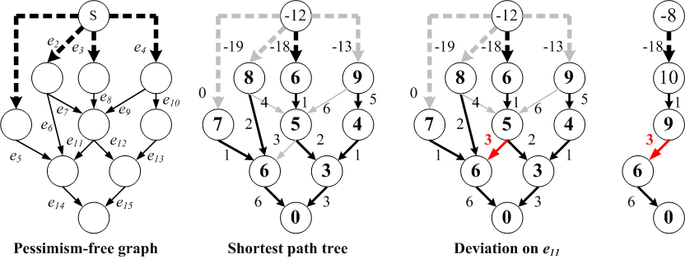
Top-k Shortest Path Finding Algorithm
O(N) explicit representation: Path = <e₁, e₂, e₃, … e_{m}>
O(1) implicit representation: Path = <e_{i}>, wrt shortest path tree
Shortest Path tree
Deviation on e₁₁

Slide 17
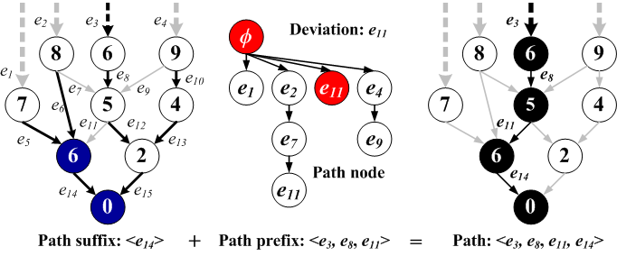
Suffix Tree and Prefix Tree
Suffix tree: shortest path tree rooted at destination node
Prefix tree: tree order of non-suffix-tree nodes (deviation)

Slide 18
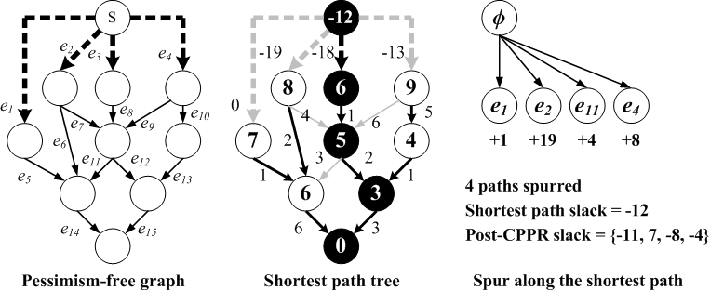
Extract Top-k Shortest Path: Supr
Take a path p and generate all other paths deviated from p
Grow the prefix tree based on deviation cost
4 paths spurred from the shortest path of slack -12
Slacks = {-11, 7, -8, -4}

Slide 19
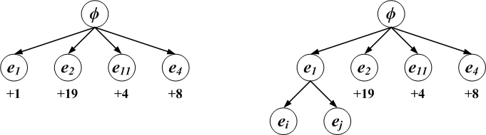
Priority Queue
Pick up a prefix-tree node with the minimum cost
Recover the path p and mark it as the k^{th} critical path
Generate all other paths deviated from p
Attach generated paths to prefix tree
Iterative expansion from the frontier node with the least cost
Spur

Slide 20
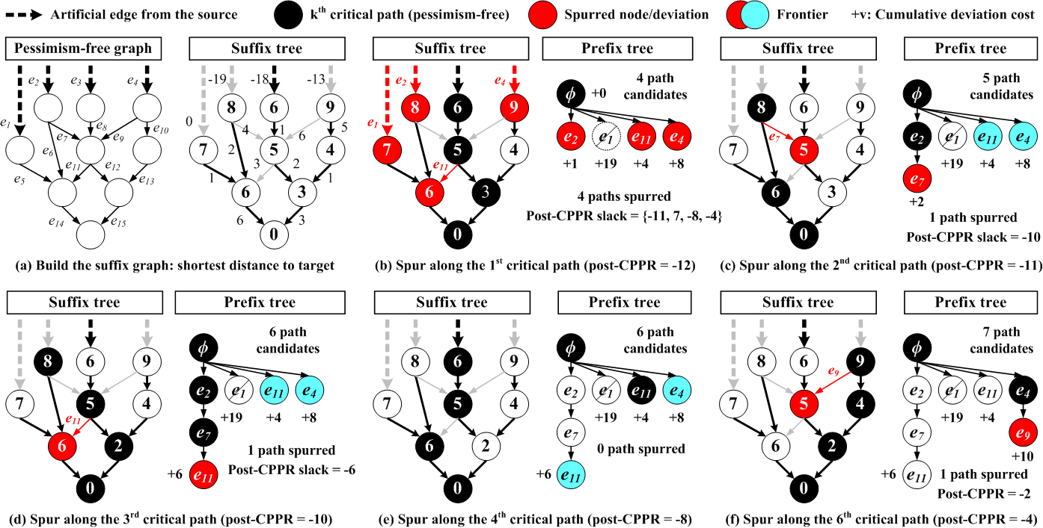
Example

Slide 21
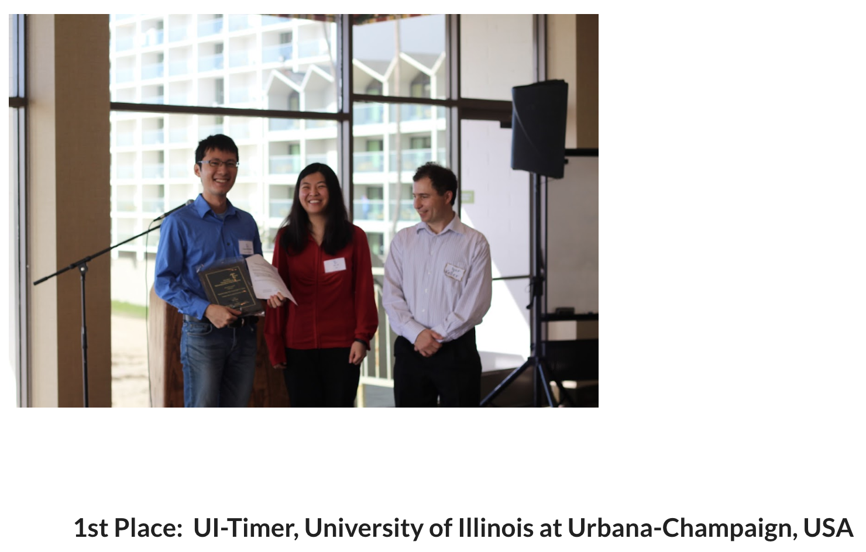
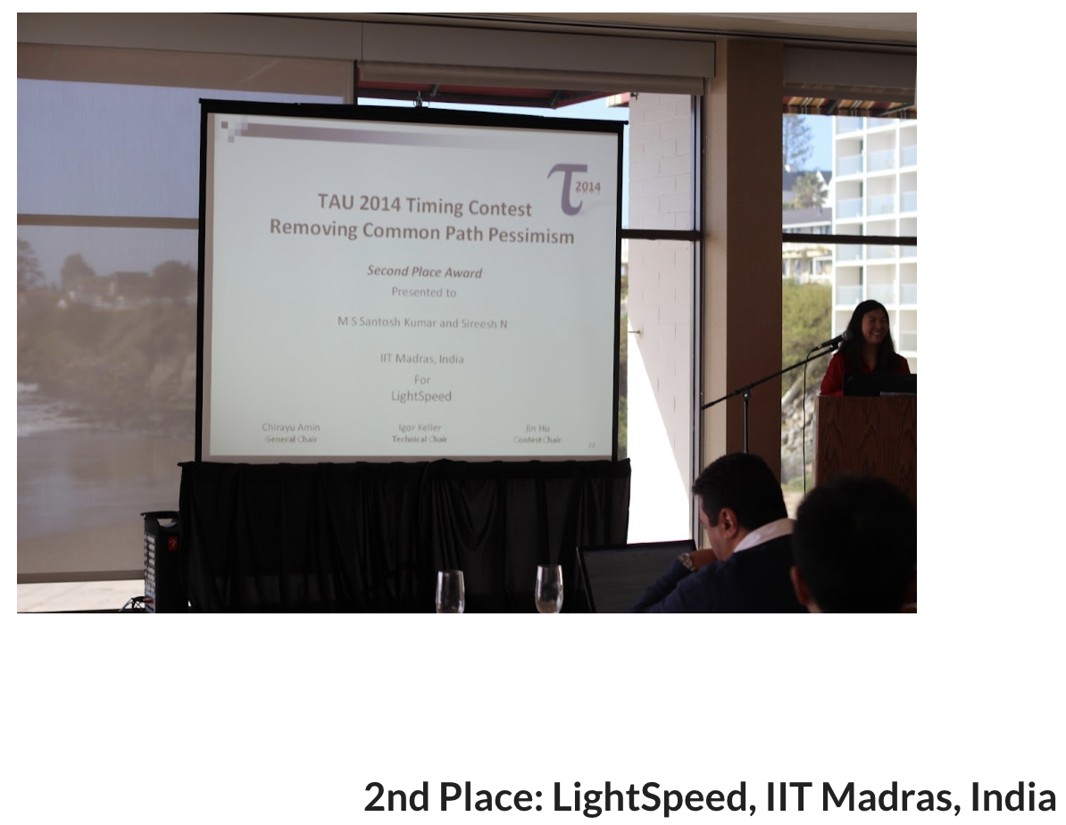
How Good is this Algorithm?
TAU 2014 Contest: Common Path Pessimism Removal (CPPR) https://sites.google.com/site/taucontest2014/

Slide 22
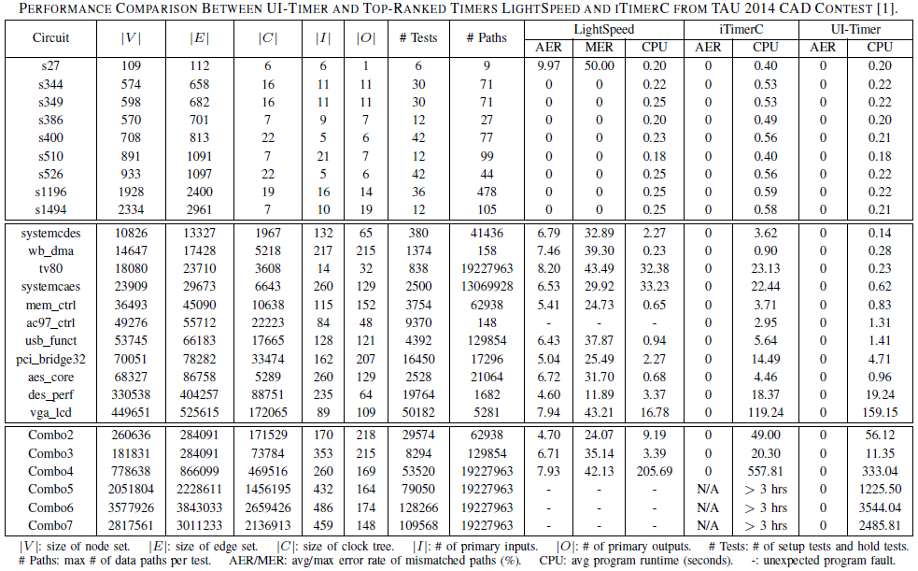
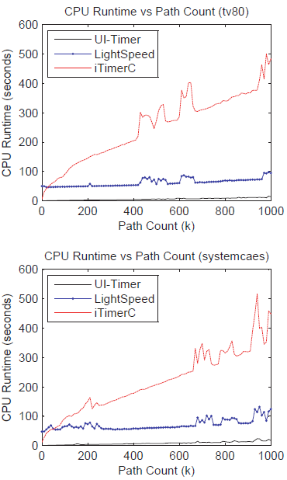
Experimental Results
Tsung-Wei Huang, P.-C. Wu, and Martin Wong, "UI-Timer: An Ultra-Fast Clock Network Pessimism Removal Algorithm," IEEE/ACM ICCAD, pp. 758-765, 2014

